Slide 1
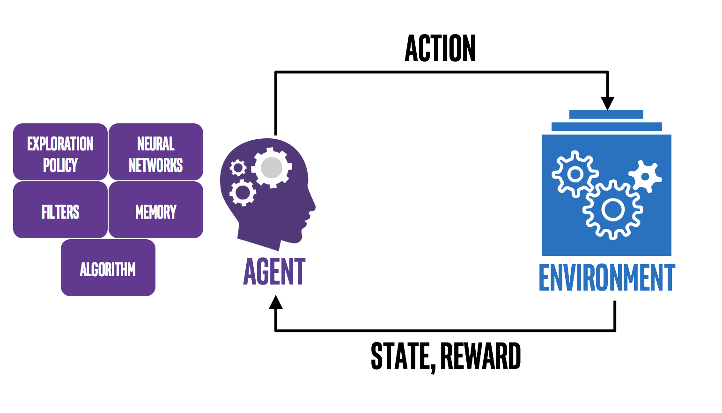
Elements of Reinforcement Learning
Hongning Wang
CS@THU

Slide 2
Outline
Action vs. reward
State vs. value
Policy
Model

Slide 3
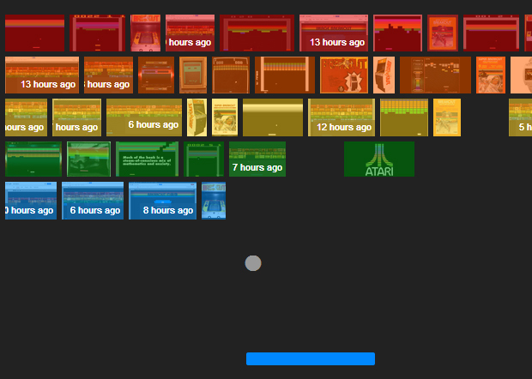
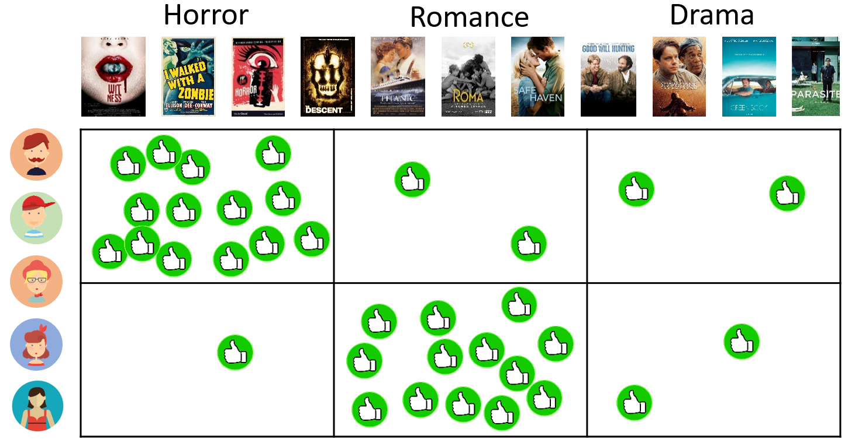
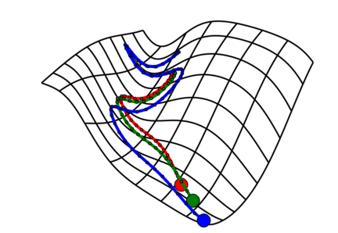
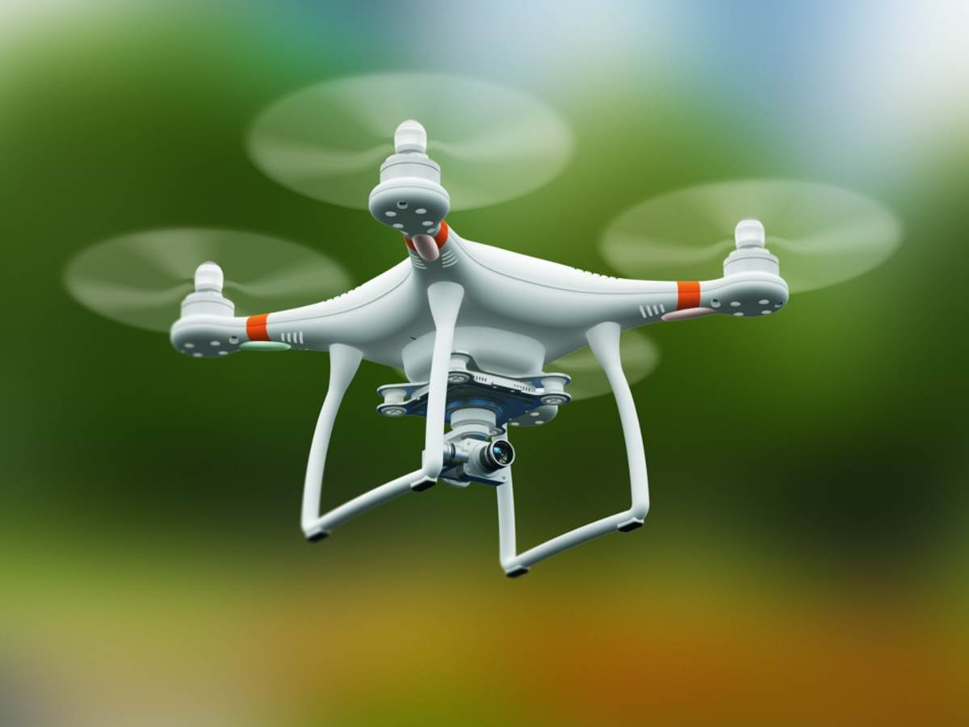
Action taking in reinforcement learning
Making a choice out of presented options
  Discrete actions
    Move left or right in Atari Breakout game
    Recommend an item to a target user
  Continuous actions
    Drone/robotics control
    Model selection/optimization with a black box function
Out of agent’s control!
Reinforcement learning is learning what to do — how to map situations to actions — so as to maximize a numerical reward signal.
- Sutton & Barto, 2018
Zeroth order optimization

Slide 4
Reward in reinforcement learning
A scalar feedback signal about the taken action
  Suggest good/bad immediate consequence of the action
    Score in Atari game
    User clicks/purchase in a recommender system
    Change of black-box function value
  Delayed feedback
    GO game
    Derivation of mathematical proofs
  Goal of learning – maximize cumulative rewards
    Reward hypothesis: “All goals can be described by the maximization of expected cumulative reward.”

Slide 5


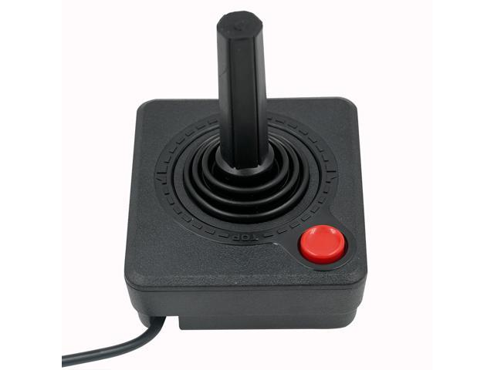




How to take an action
With respect to the current observation
Observation $o_{t}$
Action $a_{t}$
Reward $r_{t}$

Slide 6

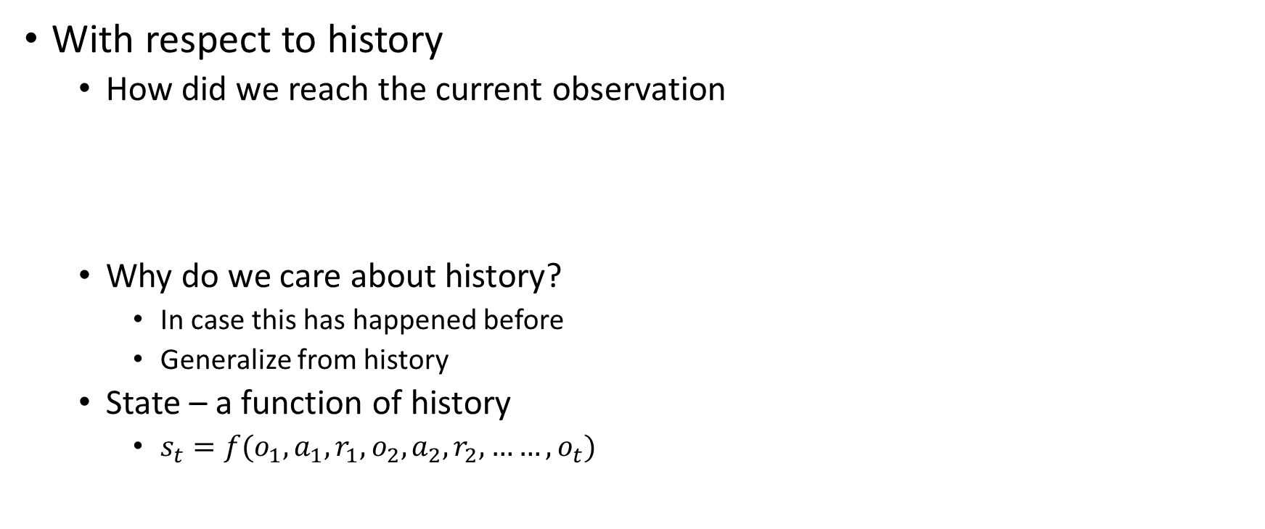

How to take an action
With respect to history
  How did we reach the current observation
  Why do we care about history?
    In case this has happened before
    Generalize from history
  State – a function of history
    $s_{t}=f(o_{1},a_{1},r_{1},o_{2},a_{2},r_{2},……,o_{t})$
$$o_{1},a_{1},r_{1},o_{2},a_{2},r_{2},……,o_{t},a_{t}$$
History
$$s_{t}$$
Current observation
How to construct states?

Slide 7

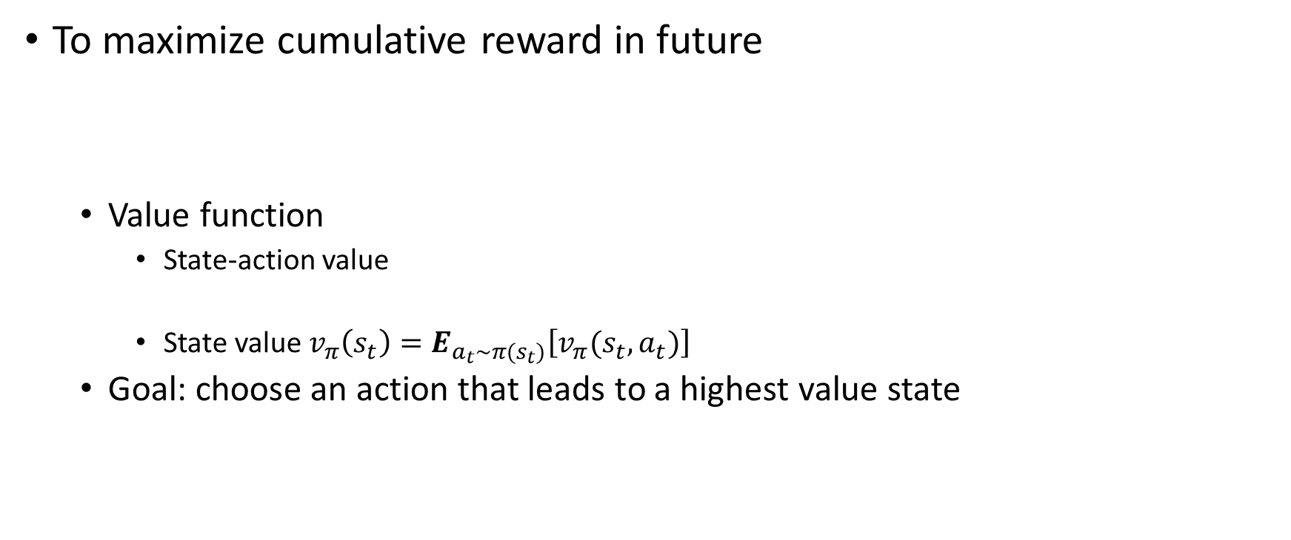

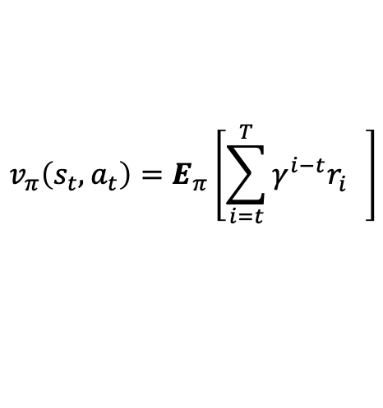
How to take an action
To maximize cumulative reward in future
  Value function
    State-action value
    State value $v_{π}\left(s_{t}\right)=E_{a_{t}∼π(s_{t})}\left[v_{π}(s_{t},a_{t})\right]$
  Goal: choose an action that leads to a highest value state
$$o_{1},a_{1},r_{1},o_{2},a_{2},r_{2},……,o_{t},a_{t},r_{t},o_{t+1},a_{t+1},r_{t+1},……,o_{T},a_{T},r_{T}$$
History
$$s_{t}$$
Future
$$v_{π}\left(s_{t},a_{t}\right)=E_{π}\left[\sum_{i=t}^{T}{γ^{i−t}r_{i}^{}}\right]$$
Oftentimes approximation is needed
With respect to a particular policy!
$$γ∈(0,1]$$
Why do we need this?

Slide 8









Action taking by value function
Shortest path as an example
  State: current node
  Action: take an outgoing edge
  Reward: (negative) edge weight
  Value: shortest distance to the target node
Now how should we act?
$$v\left(g\right)=−2$$
$$v\left(t\right)=0$$
$$v\left(d\right)=−4$$
2
g
2
1
t
b
d
4
$$v\left(b\right)=−5$$
4
2
a
4
9
$$v\left(a\right)=−9$$
f
2
c
e
5
$$v\left(f\right)=−2$$
3
$$v\left(e\right)=−7$$
$$v\left(c\right)=−8$$
w.r.t. optimal policy

Slide 9









Action taking by value function
Shortest path as an example
  State: current node
  Action: take an outgoing edge
  Reward: (negative) edge weight
  Value: expected shortest distance to the target node
Now how should we act?
$$v\left(g\right)=−2$$
2
$$v\left(t\right)=0$$
$$v\left(d\right)=−4$$
2
g
$$v\left(b\right)=−5$$
1
t
b
d
4
P=0.2
4
2
$$v\left(e\right)=−5+0.5×v\left(t\right)+0.5×v\left(f\right)=−6$$
a
4
9
P=0.5
$$v\left(a\right)=\max\left\{−4+v\left(b\right),−2+0.2×v\left(d\right)+0.8×v\left(c\right)\right\}$$
$=−9$
f
2
P=0.8
P=0.5
$$−9.2$$
e
5
$$v\left(f\right)=−2$$
c
3
$$v\left(e\right)=−6$$
$$v\left(c\right)=−8$$
Example credit: Jiang, UIUC CS-498
w.r.t. optimal policy

Slide 10


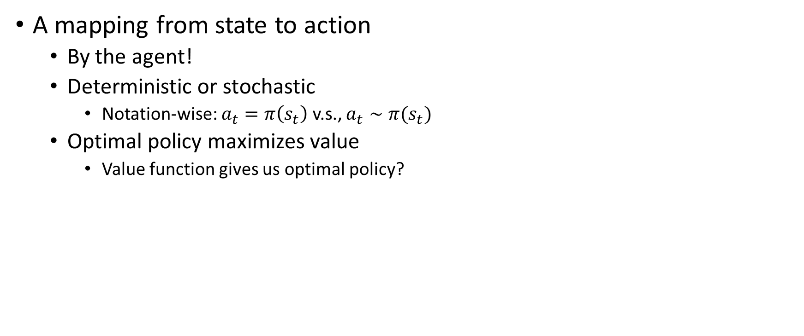

Policy
A mapping from state to action
  By the agent!
  Deterministic or stochastic
    Notation-wise: $a_{t}=π\left(s_{t}\right)$ v.s., $a_{t}∼π(s_{t})$
  Optimal policy maximizes value
    Value function gives us optimal policy?
$$v\left(g\right)=−2$$
$$v\left(t\right)=0$$
$$v\left(d\right)=−4$$
2
g
2
1
t
b
d
Act greedily
4
$$v\left(b\right)=−5$$
4
2
a
4
9
$$v\left(a\right)=−9$$
$$π^{∗}\left(a\right)=→b$$
f
2
c
e
5
$$v\left(f\right)=−2$$
3
$$v\left(e\right)=−7$$
$$π^{∗}\left(f\right)=→t$$
$$v\left(c\right)=−8$$
$$π^{∗}\left(c\right)=→d$$

Slide 11







Prediction vs. Control
Prediction
  Evaluate value function given a policy
Control
  Optimize policy
Sort of E-step vs., M-step?
$$v\left(g\right)=−2$$
$$v\left(t\right)=0$$
$$v\left(d\right)=−4$$
2
g
2
1
t
b
d
Found a way to improve current policy
4
$$v\left(b\right)=−5$$
4
2
$$v\left(a\right)=−10.6$$
a
4
9
f
2
c
e
5
$$v\left(f\right)=0.5×\left(−2\right)+0.5×\left(−4−2\right)=−4$$
3
$$v\left(e\right)=−9$$
$$v\left(c\right)=−10.3$$
w.r.t. a uniformly random policy

Slide 12
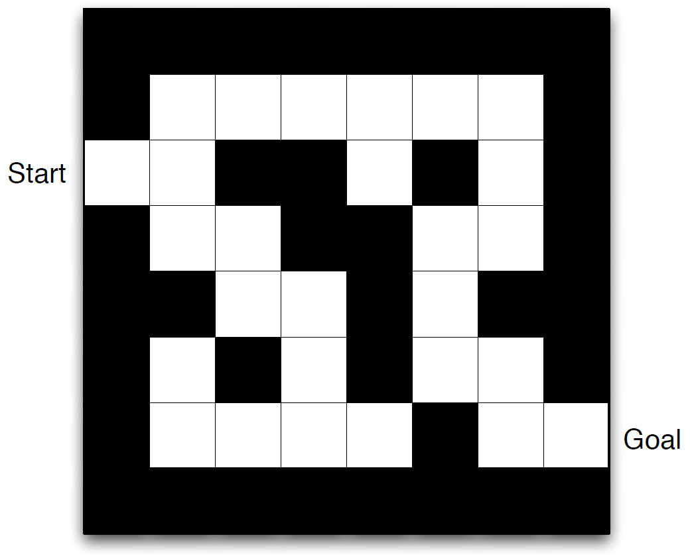
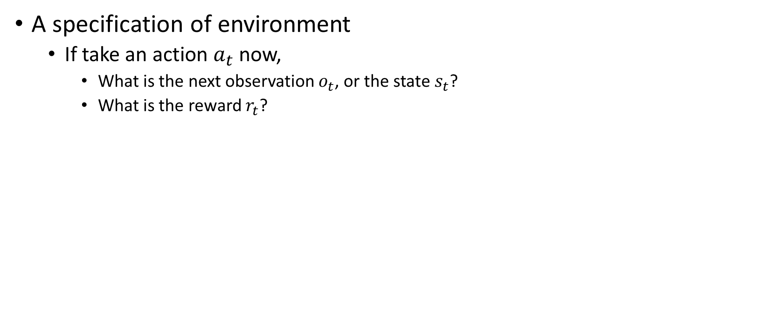
Model
A specification of environment
  If take an action $a_{t}$ now,
    What is the next observation $o_{t}$, or the state $s_{t}$?
    What is the reward $r_{t}$?
Action: N,S,E,W
Reward: -1
State: current position
Model: configuration of the maze
E
Example credit: David Silver, “Introduction to RL”

Slide 13
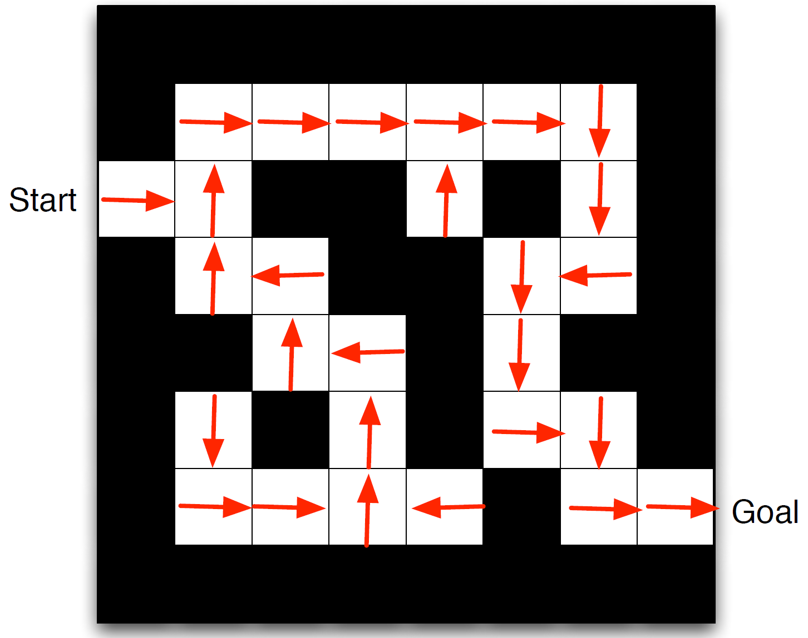
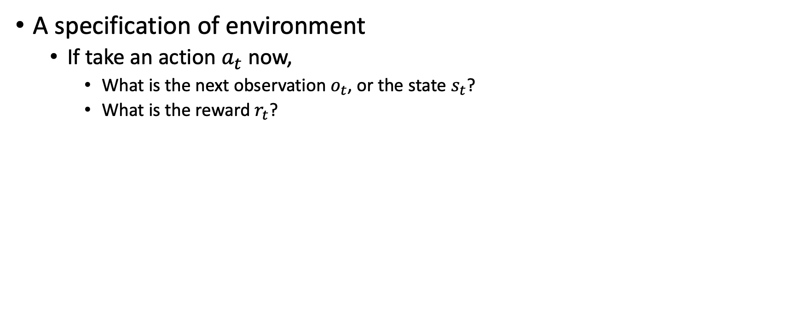
Model
A specification of environment
  If take an action $a_{t}$ now,
    What is the next observation $o_{t}$, or the state $s_{t}$?
    What is the reward $r_{t}$?
Optimal policy
Action: N,S,E,W
Reward: -1
State: current position
Model: configuration of the maze
Should be defined for all states!
Example credit: David Silver, “Introduction to RL”

Slide 14
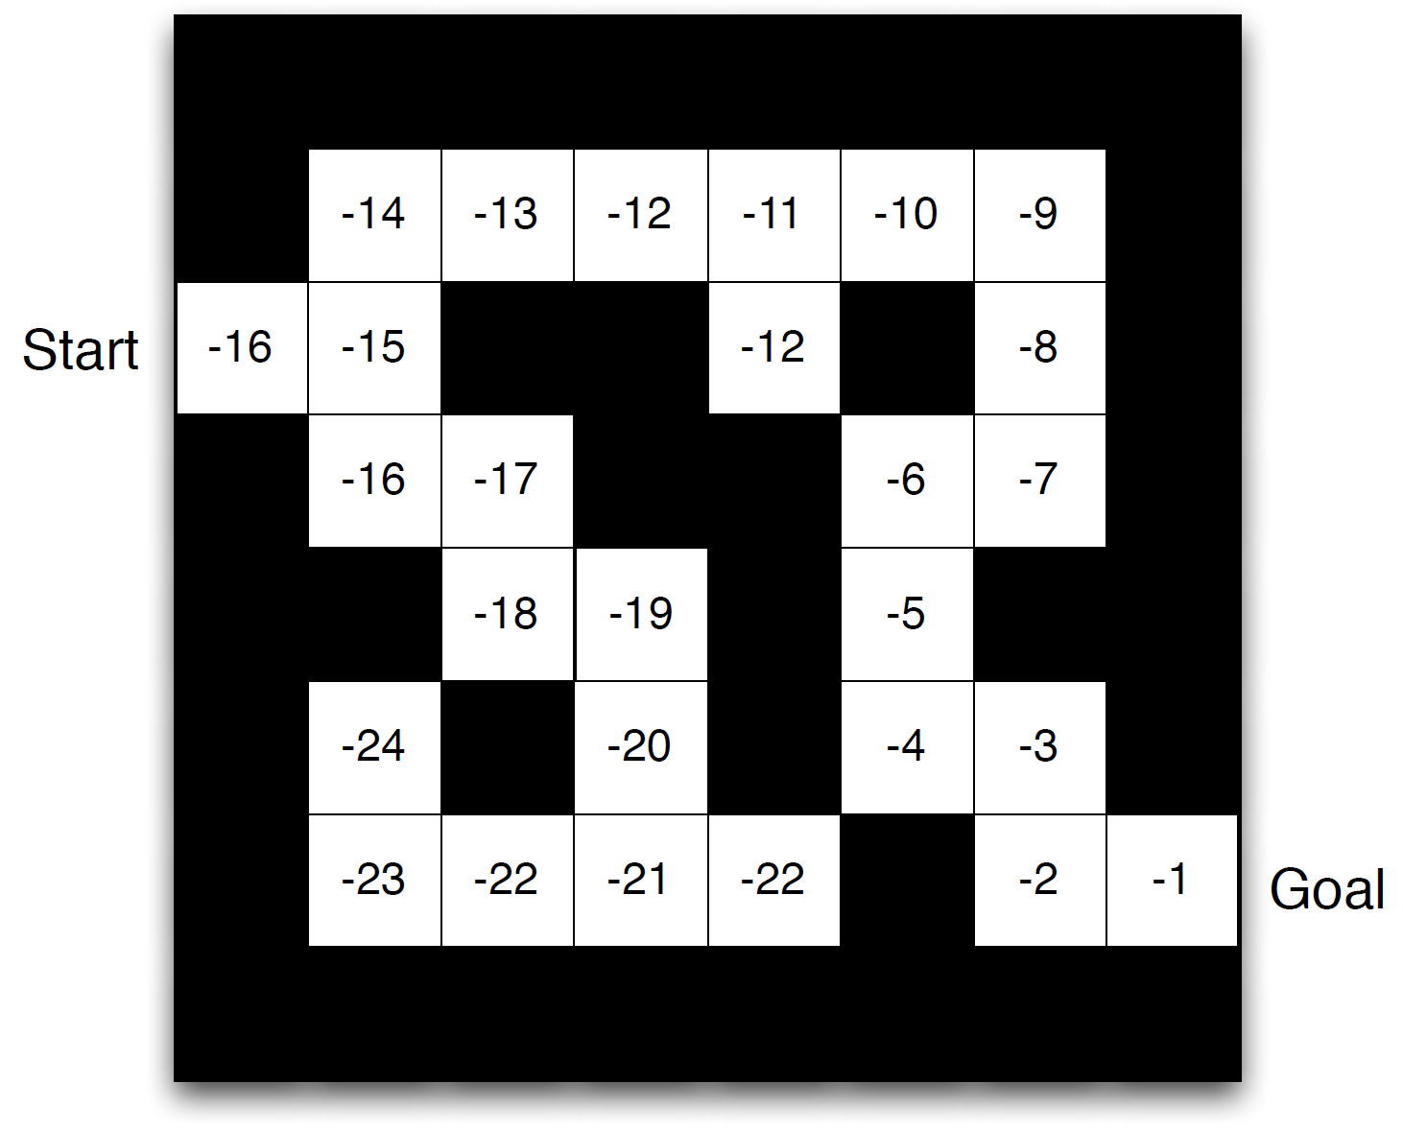
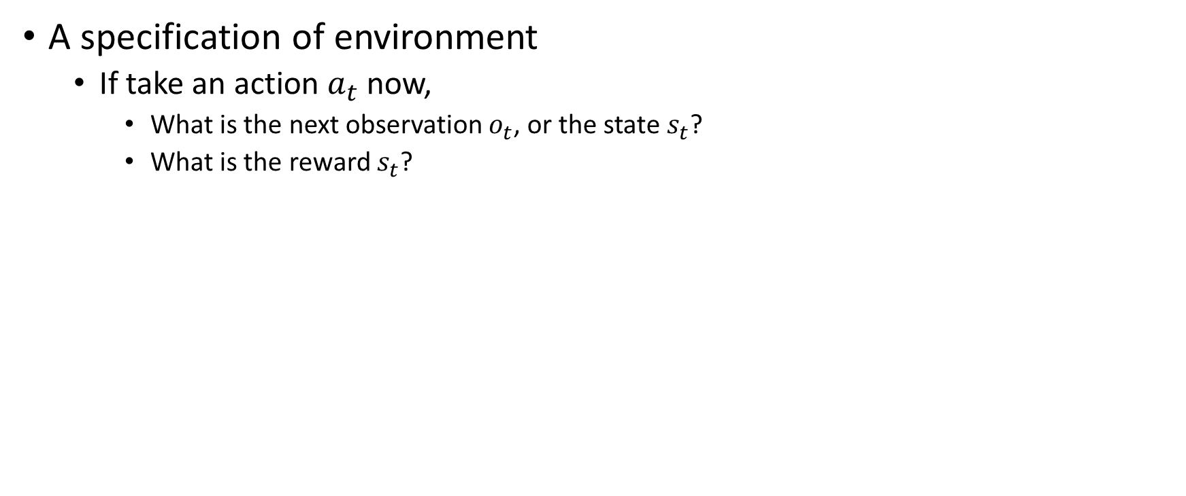
Model
A specification of environment
  If take an action $a_{t}$ now,
    What is the next observation $o_{t}$, or the state $s_{t}$?
    What is the reward $s_{t}$?
Value under optimal policy
Action: N,S,E,W
Reward: -1
State: current position
Model: configuration of the maze
Example credit: David Silver, “Introduction to RL”

Slide 15
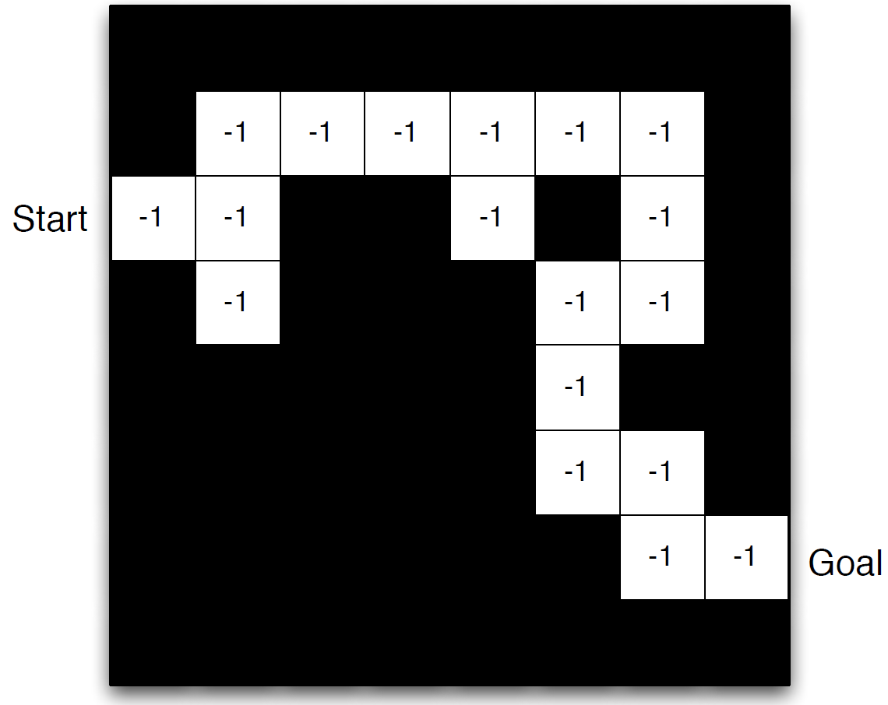
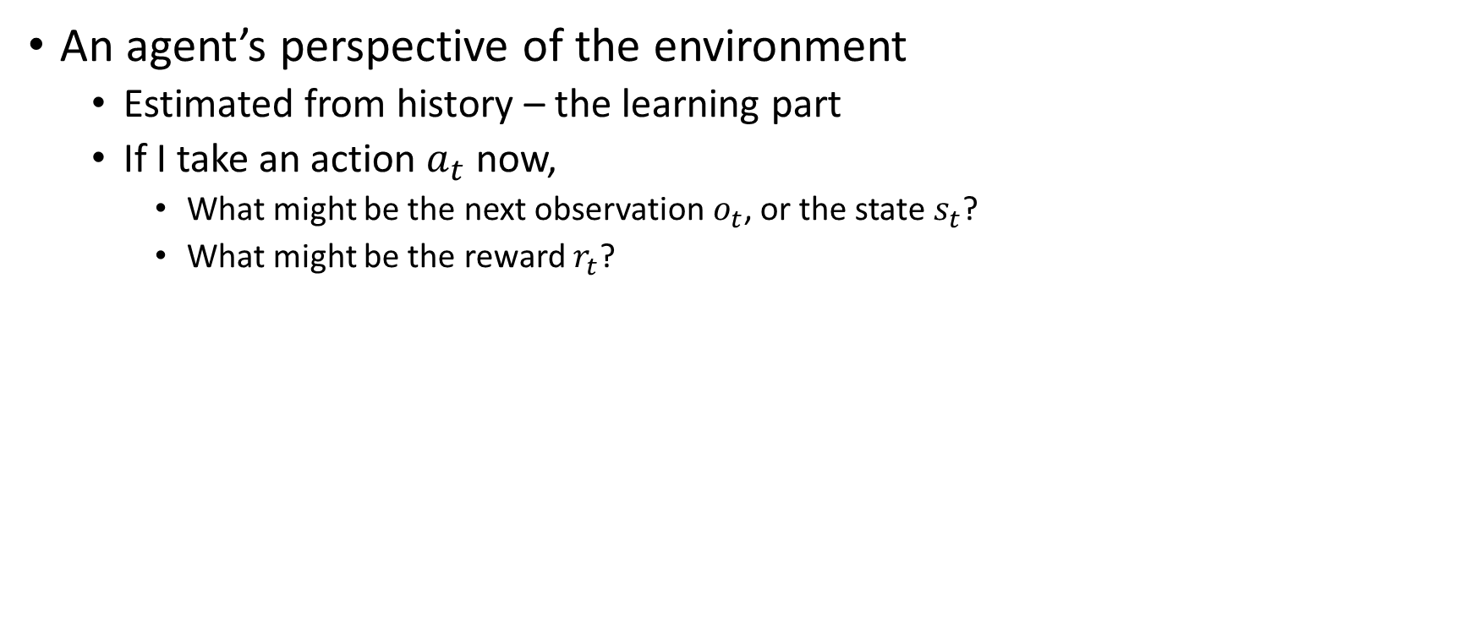
(Estimated) Model
An agent’s perspective of the environment
  Estimated from history – the learning part
  If I take an action $a_{t}$ now,
    What might be the next observation $o_{t}$, or the state $s_{t}$?
    What might be the reward $r_{t}$?
Action: N,S,E,W
Reward: -1 for visited states so far
State: current position
Model: estimated configuration of the maze

Slide 16
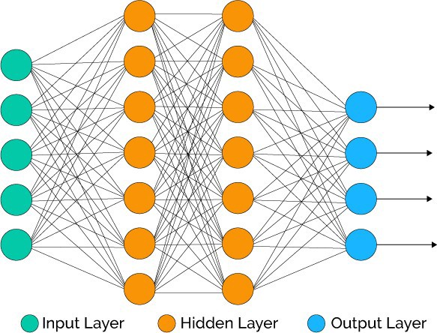
Models
Environment model
  Ground-truth construction
  Might be given sometimes
Estimated environment model
  Agent’s belief
  Might not be truthful
Agent’s model
  The mathematical/ statistical formulation used by the agent for estimation

Slide 17
Takeaways
RL agents take actions with respect to history/state
Their goal is to find the highest value states
Model is about the environment, and can be estimated by the agent

